Slide 1
Amazon Web Services - Config
Abdul Rasheed Feroz Khan
Director – CodeSizzler
feroz@codesizzler.info

Slide 2
Topics:
What is AWS Config?
How it works?
Benefits

Slide 3
What is AWS Config?
AWS Config helps you to assess, audit, and evaluate the configurations of your AWS resources

Slide 4
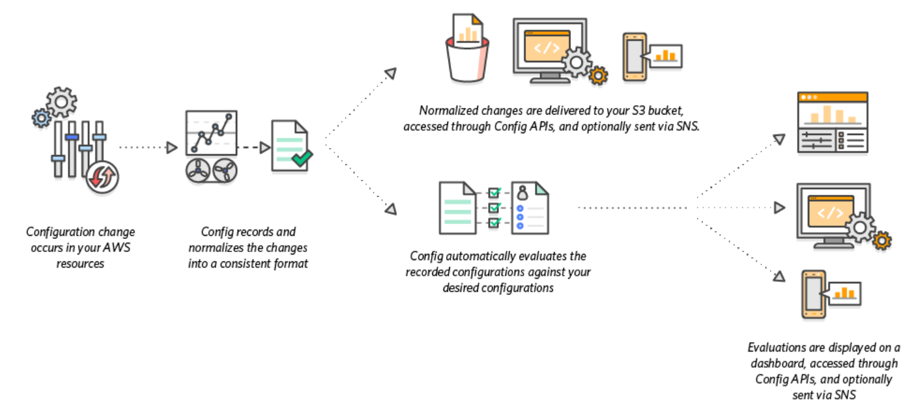
How it works?

Slide 5
Benefits of AWS Config:
Continuous Monitoring
Continuous Assessment
Change Management
Operational Troubleshooting

Slide 6
Use cases for AWS Config
Discovery with snapshot
Change Management with SNS
Compliance as Code with AWS Lambda
Troubleshoot

Slide 7
Hands on with AWS Config

Slide 8
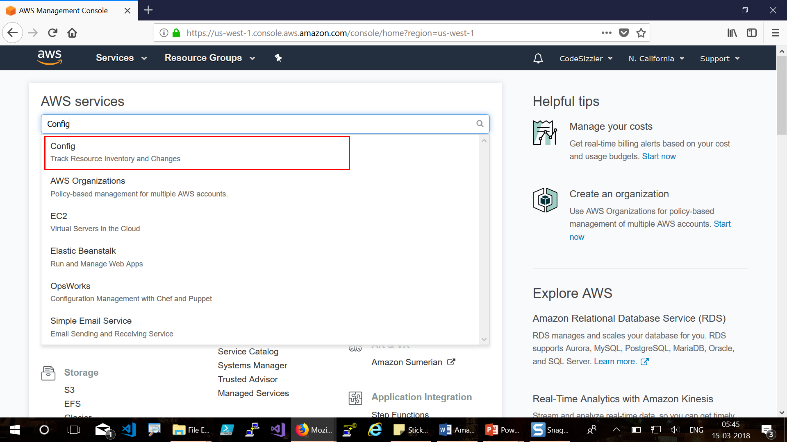

Slide 9
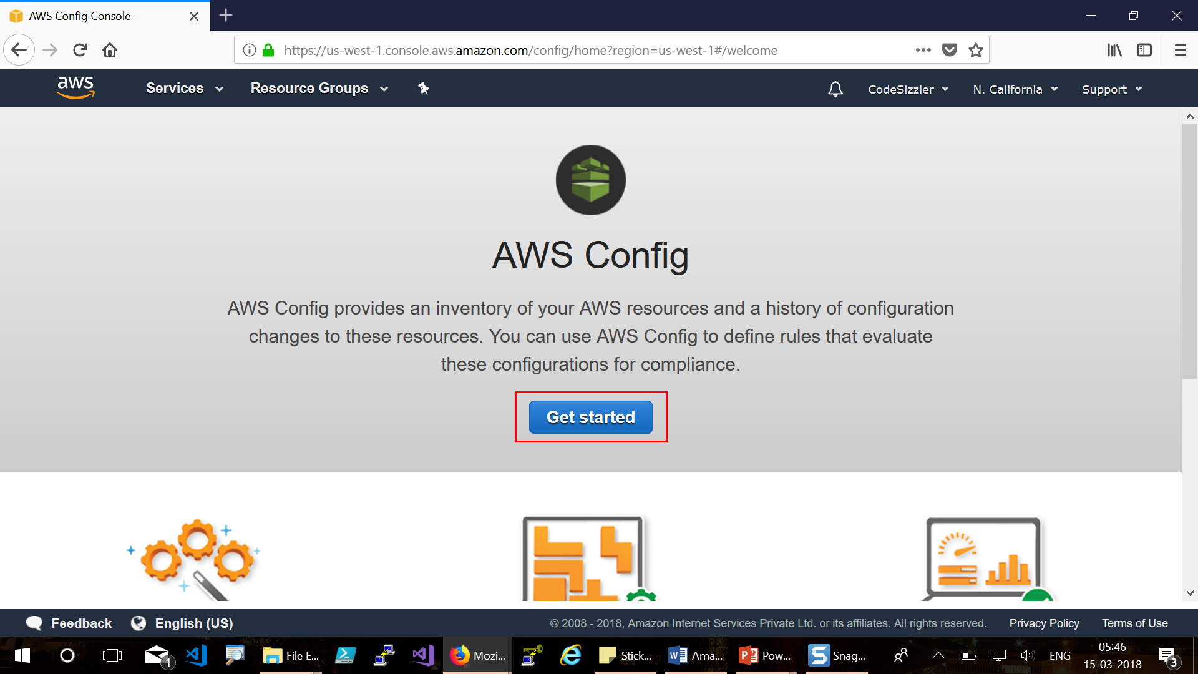

Slide 10
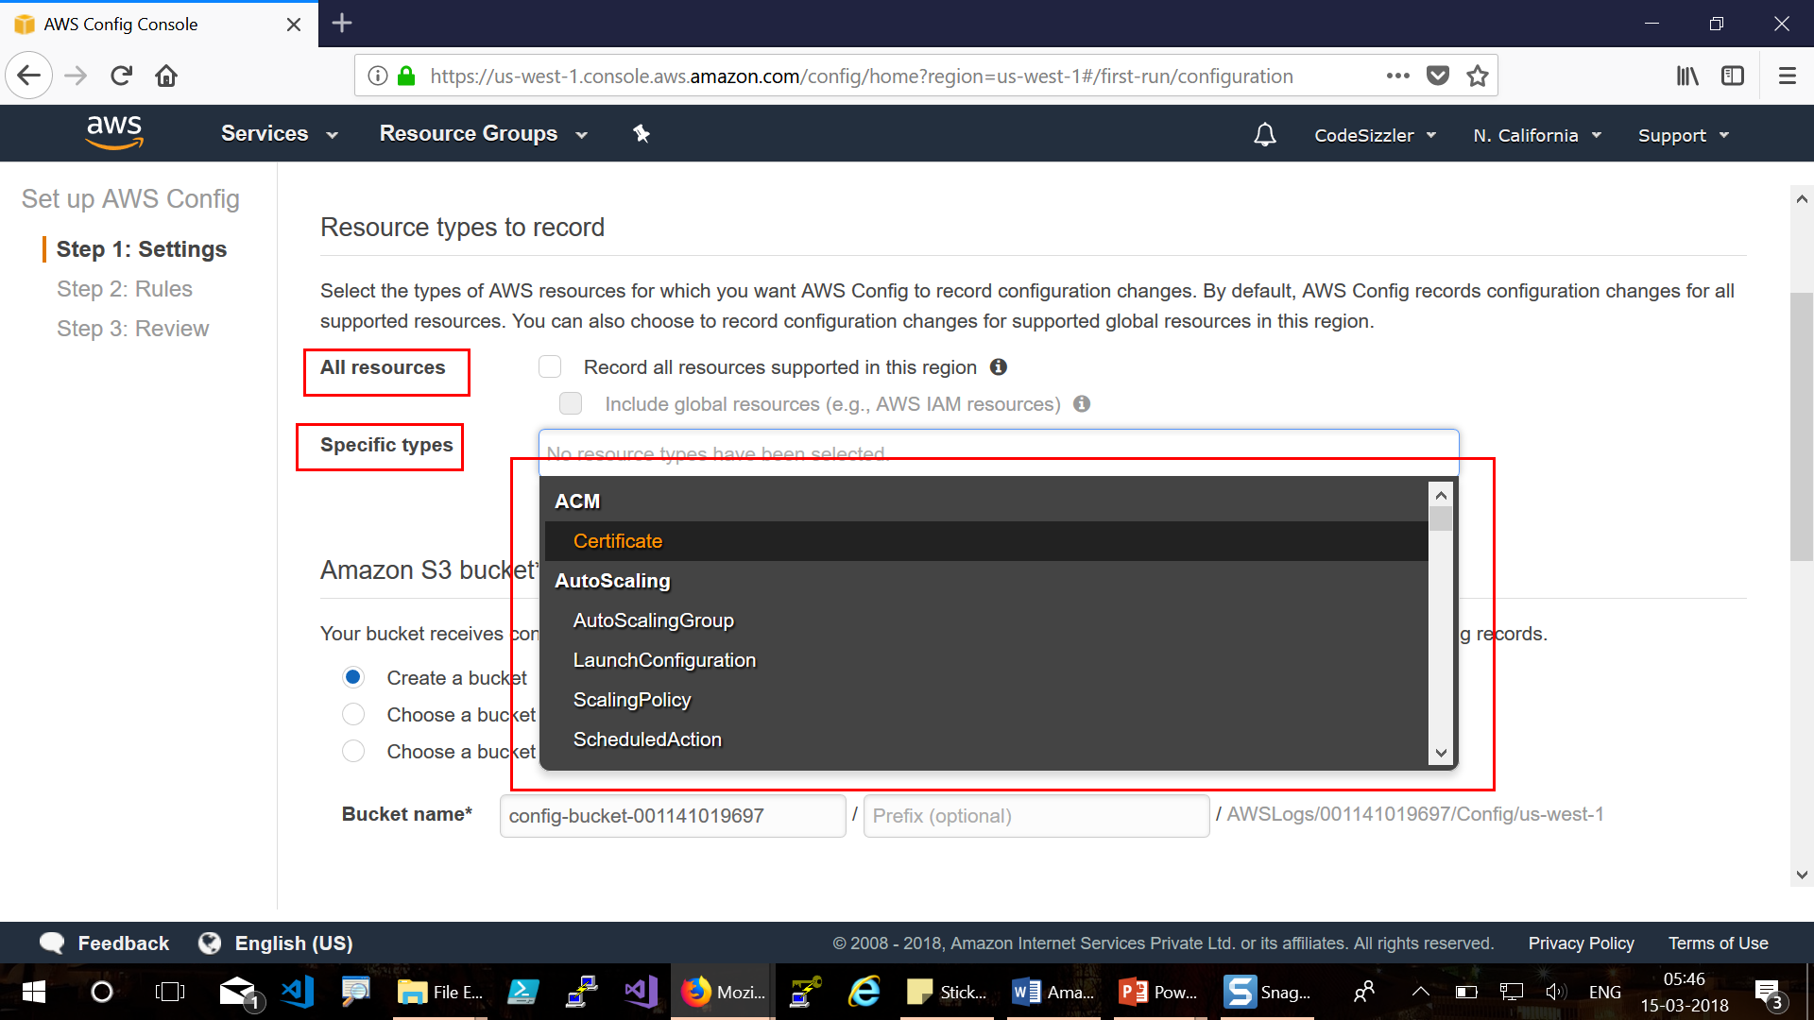

Slide 11
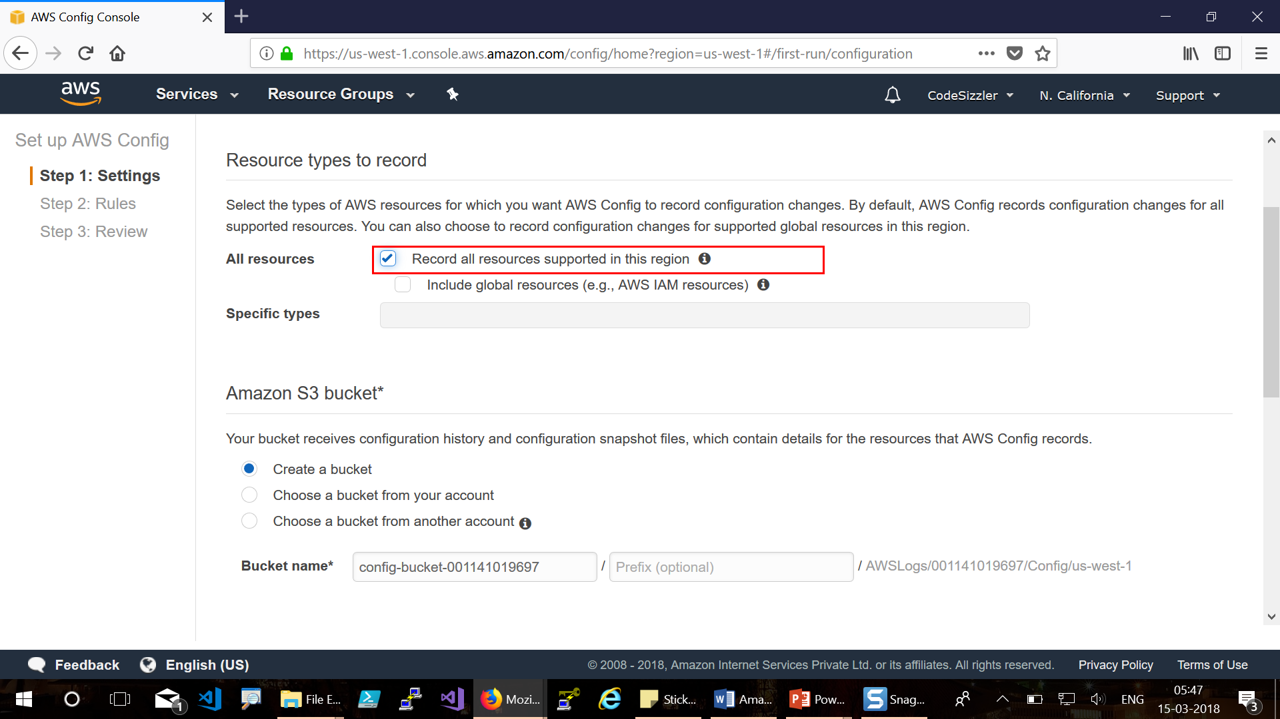

Slide 12
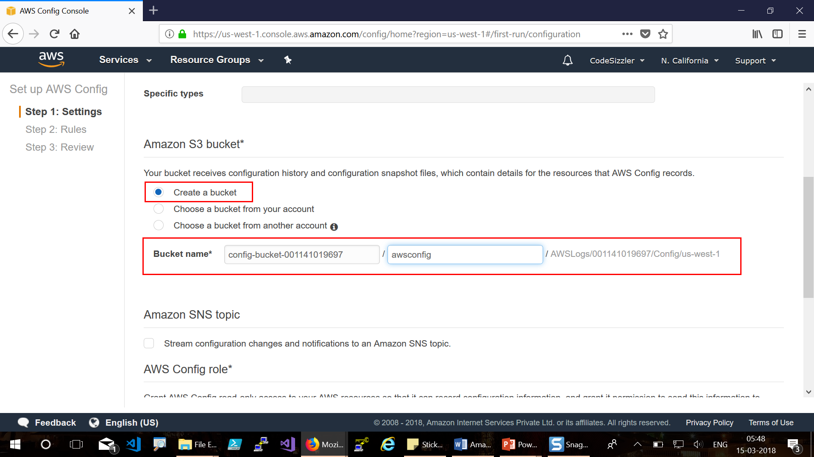

Slide 13
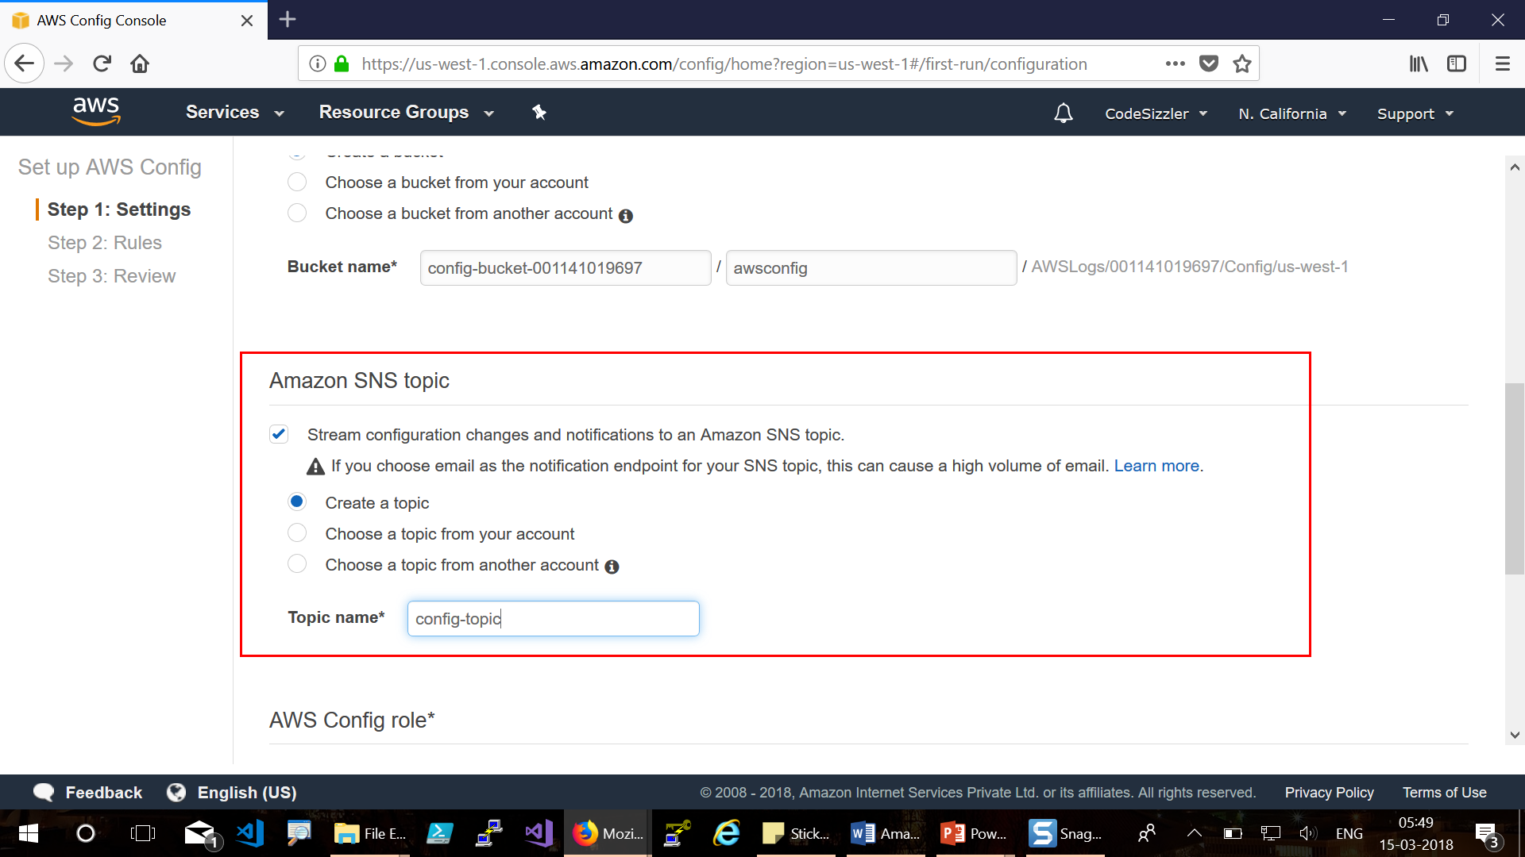

Slide 14
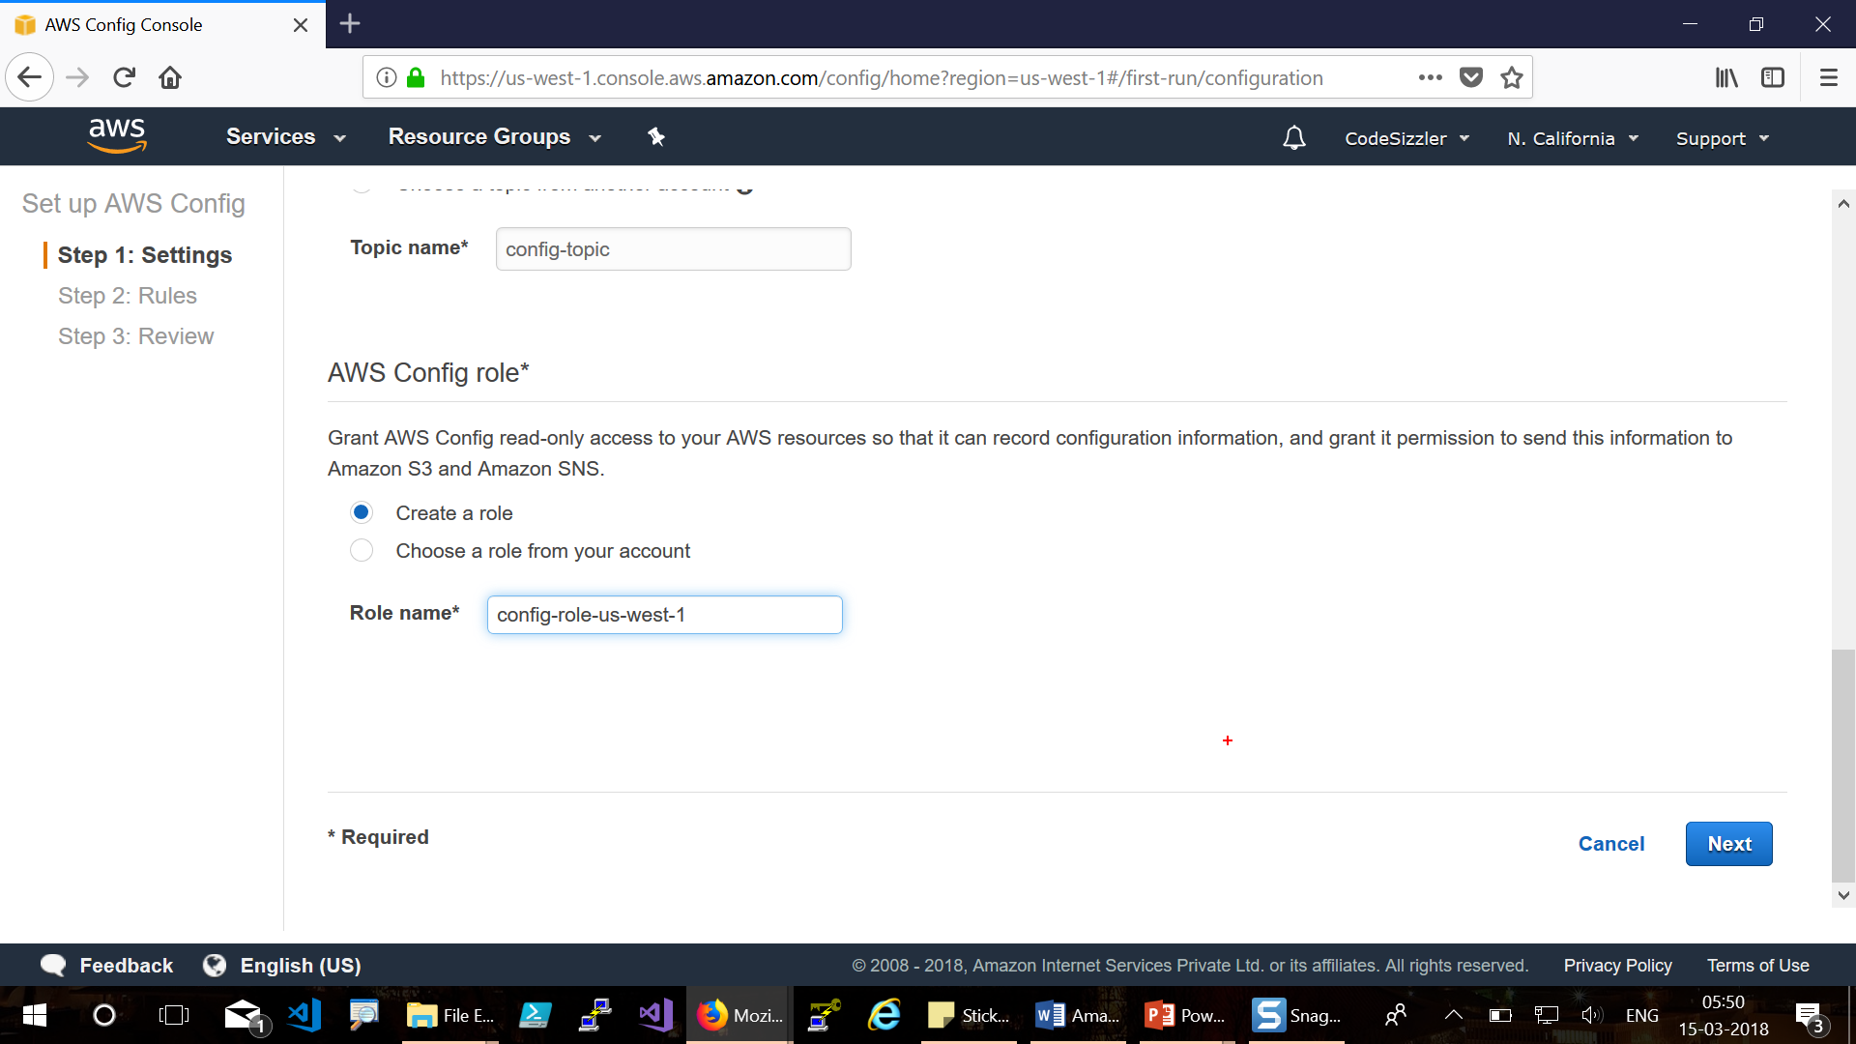

Slide 16
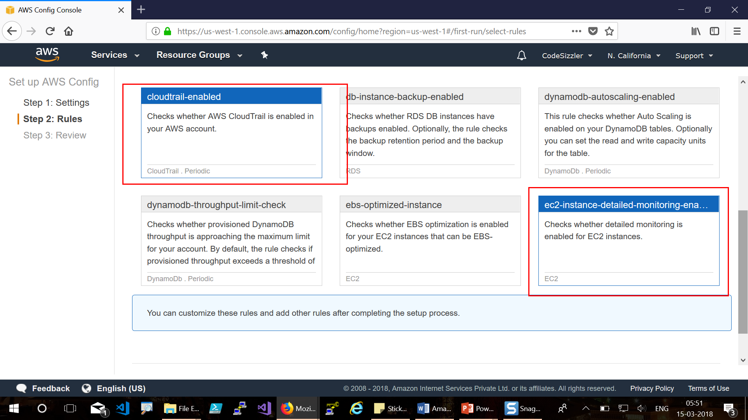

Slide 17
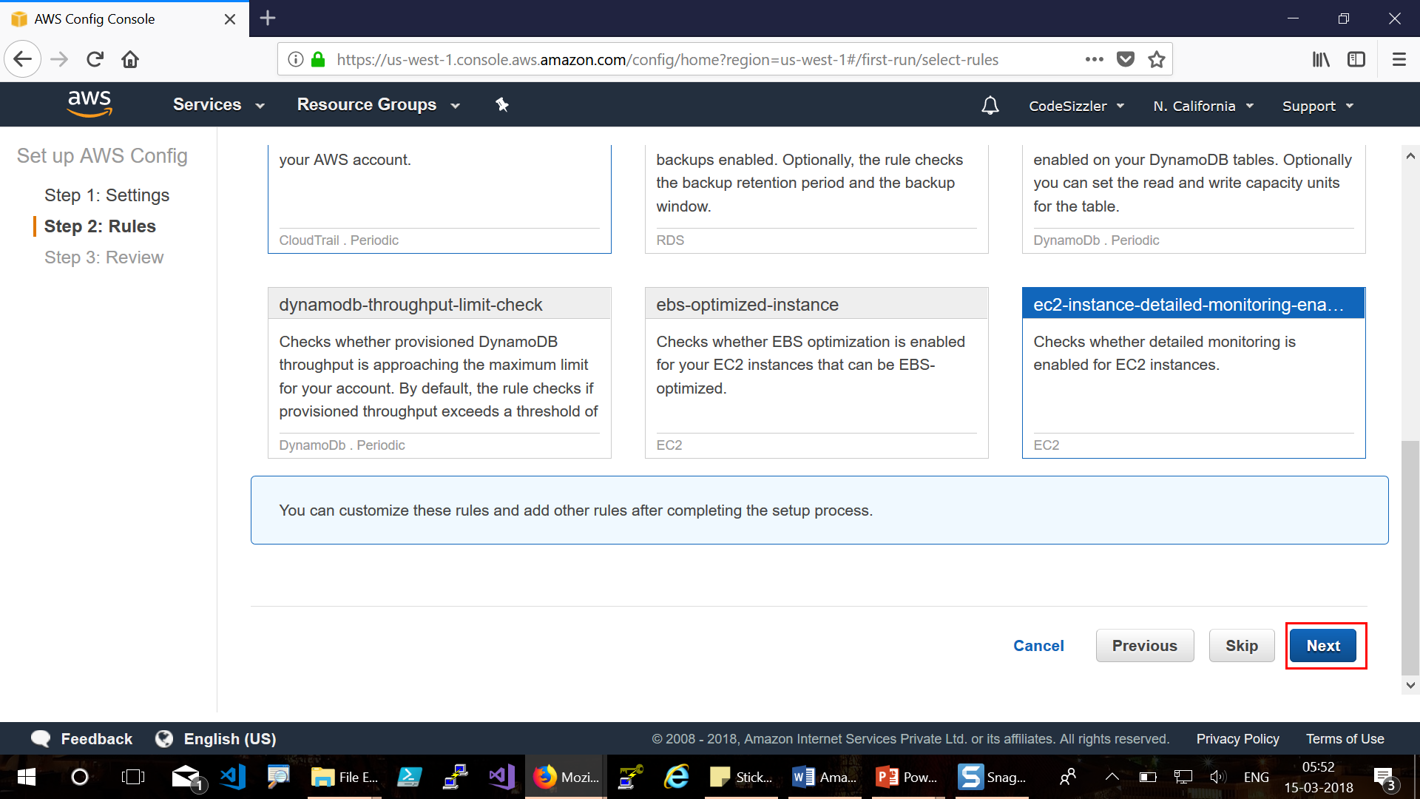

Slide 18
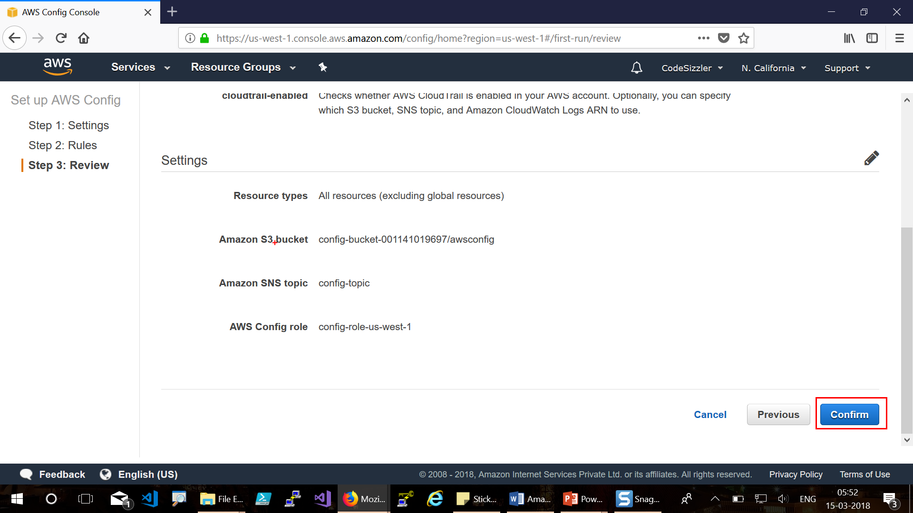

Slide 19
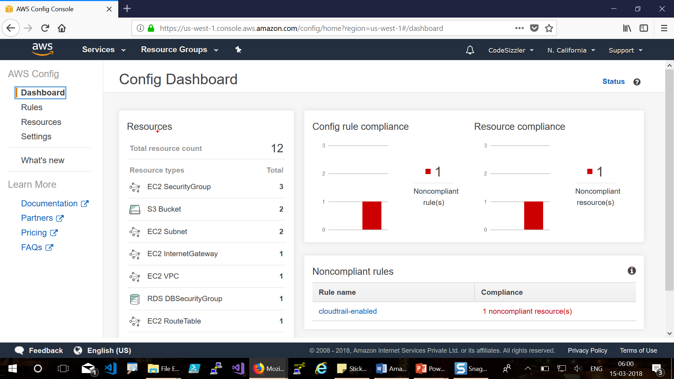

Slide 20
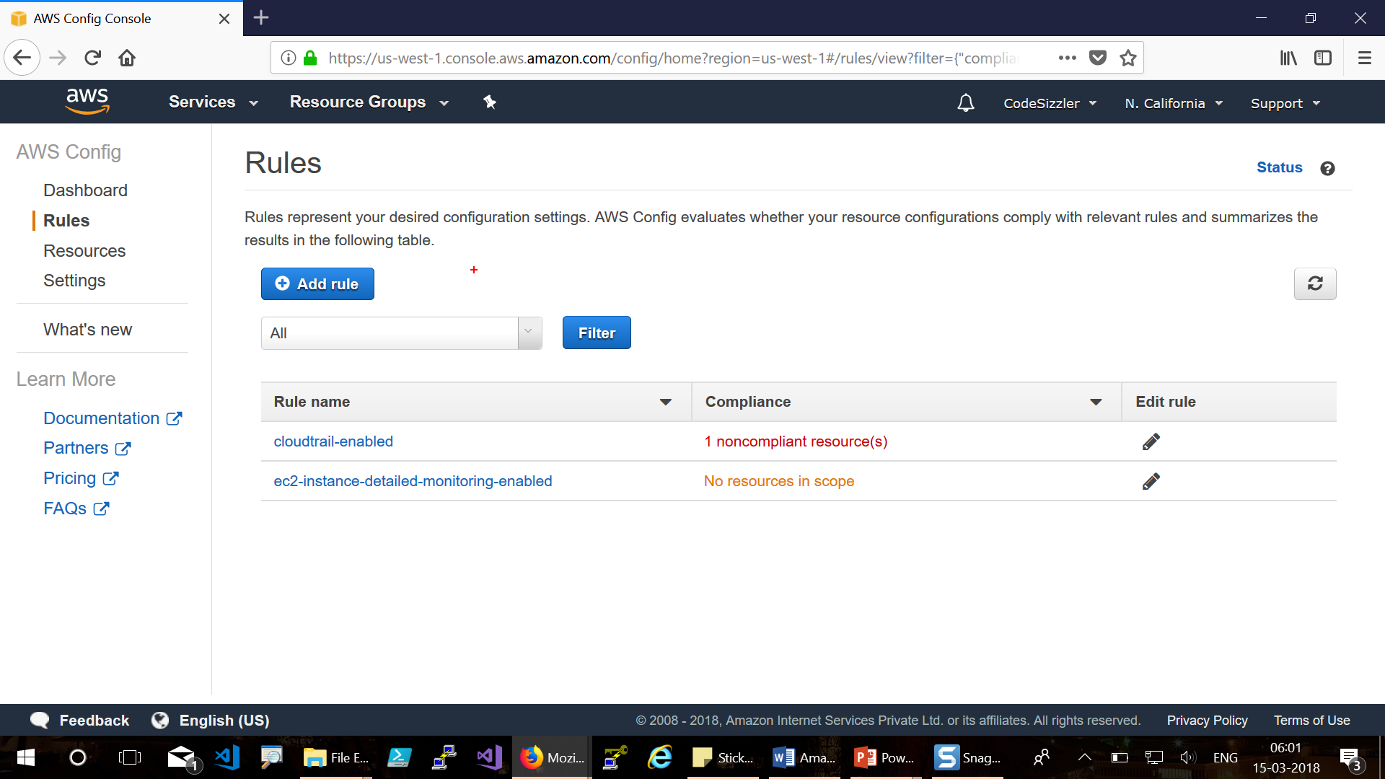

Slide 21
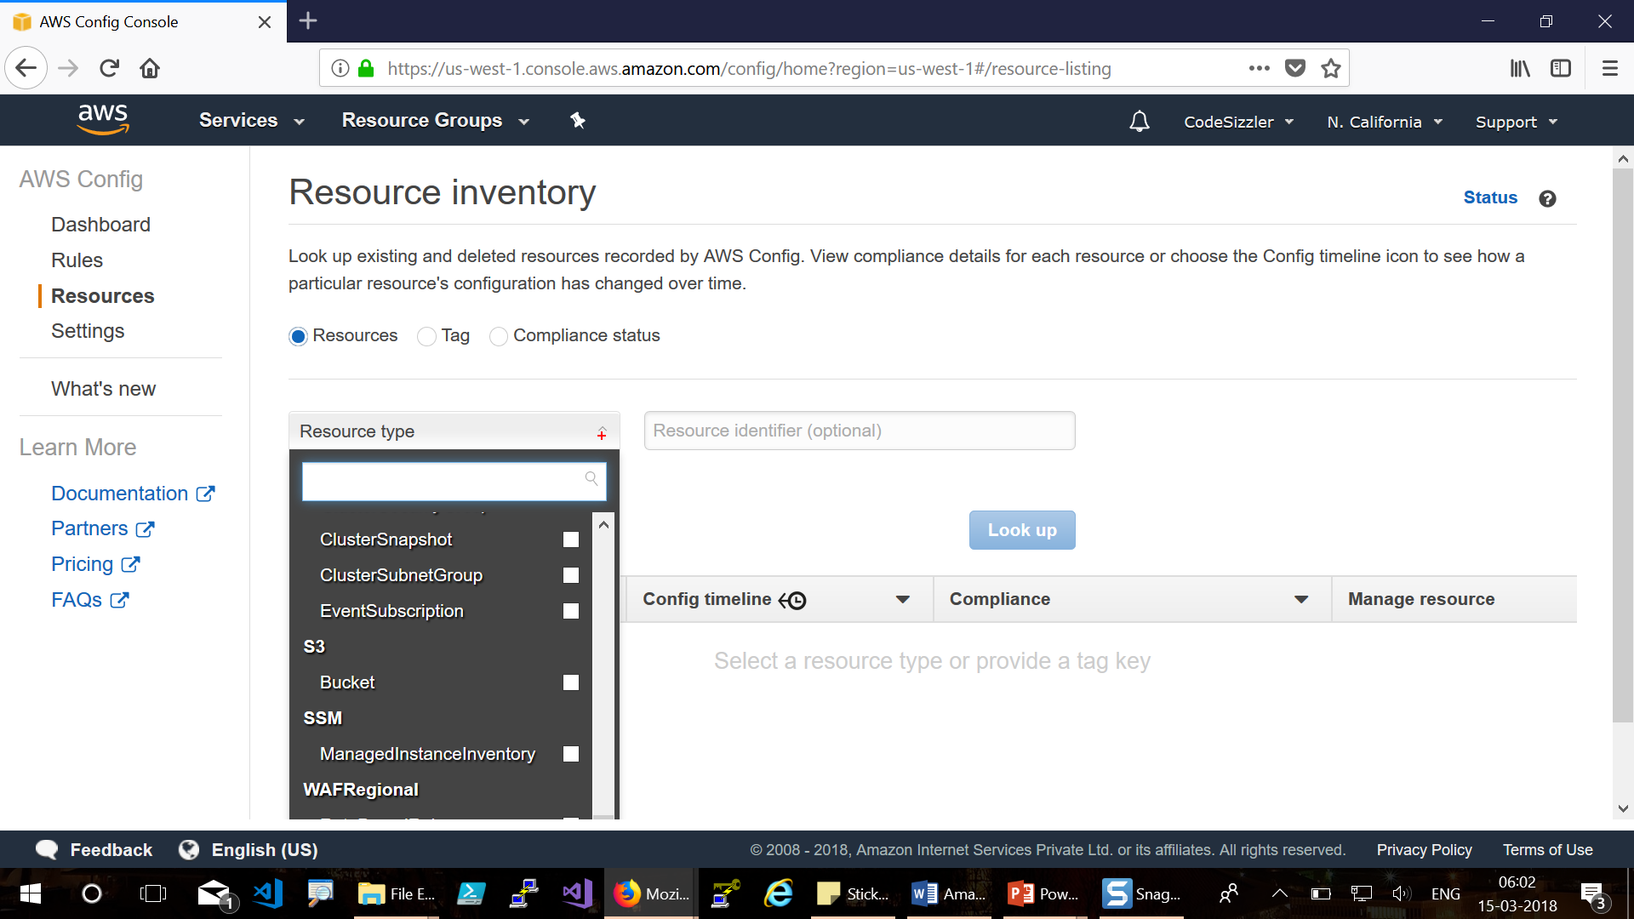

Slide 22
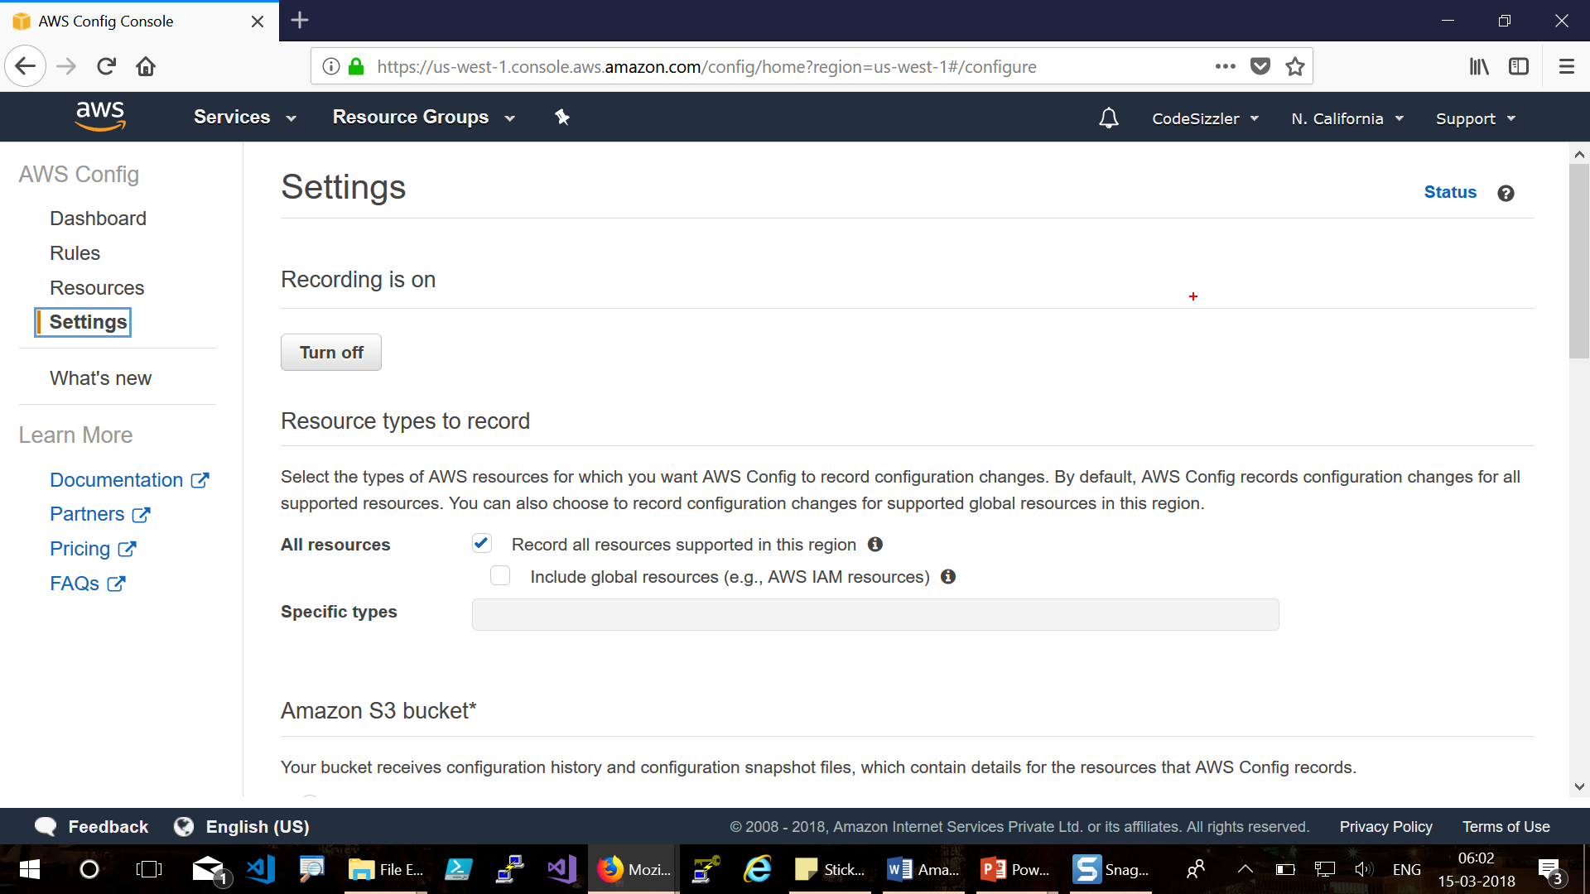

Slide 23

For queries reach us @ codesizzler@outlook.com
Twitter - @TechFero | @CodeSizzler

